Slide 1
Computer Organization تنظيم الحاسوب
Chapter 5
Large and Fast: Exploiting Memory
Hierarchy
Dr. Mahmoud Masadeh

Slide 2
Large and Fast: Exploiting Memory Hierarchy

Slide 3
5.1 Introduction: Principle of Locality
Programs access a small proportion of their address space at any time
Temporal locality
Items accessed recently are likely to be accessed again soon
e.g., instructions in a loop, induction variables
Spatial locality
Items near those accessed recently are likely to be accessed soon
E.g., sequential instruction access, array data

Slide 4
Taking Advantage of Locality
Memory hierarchy
Store everything on disk
Copy recently accessed (and nearby) items from disk to smaller DRAM memory
Main memory
Copy more recently accessed (and nearby) items from DRAM to smaller SRAM memory
Cache memory attached to CPU

Slide 5
Memory Hierarchy Levels
Block (line): unit of copying
May be multiple words
If accessed data is present in upper level
Hit: access satisfied by upper level
Hit ratio: hits/accesses
If accessed data is absent
Miss: block copied from lower level
Time taken: miss penalty
Miss ratio: misses/accesses = 1 – hit ratio
Then accessed data supplied from upper level
Hit time: The time required to access a level of the memory hierarchy, including the time needed to determine whether the access is a hit or a miss.
Miss penalty: The time required to fetch a block into a level of the memory hierarchy from the lower level
Memory hierarchy: A structure that uses
multiple levels of memories; as the distance from the processor increases, the size of the memories and the access time both increase.

Slide 6
5.2 Memory Technology
Main memory/ Dynamic RAM (DRAM)
Cache Memory/ Static RAM (SRAM)
Flash memory: Nonvolatile memory is the secondary memory in Personal Mobile Devices
Magnetic disk: used to implement the largest and slowest level in the hierarchy in servers
Ideal memory: Access time of SRAM , Capacity and cost/GB of disk

Slide 7
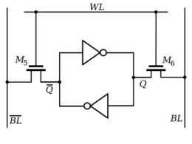
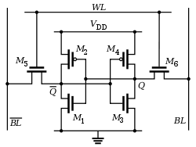
SRAM Technology
SRAMs are simply integrated circuits that are memory arrays with a single access port that can provide either a read or a write.
SRAMs have a fixed access time to any datum
SRAMs don’t need to refresh and so the access time is very close to the cycle time.
SRAMs typically use six to eight transistors per bit to prevent the information from being disturbed when read.
SRAM needs only minimal power to retain the charge in standby mode.
As long as power is applied, the value can be kept indefinitely

Slide 8
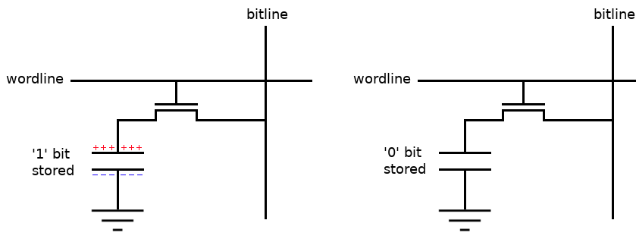
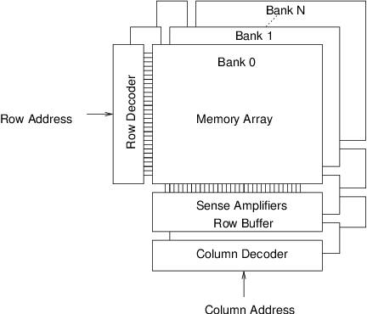
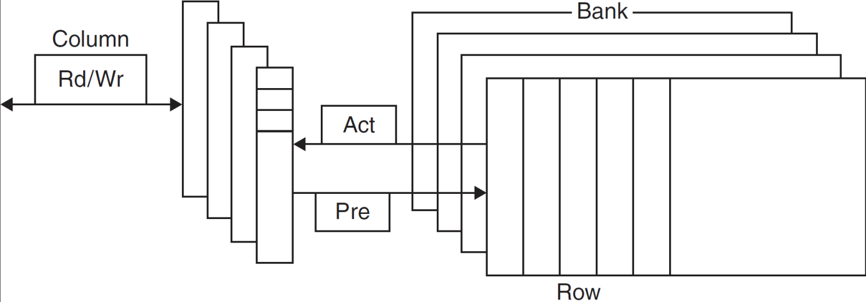
DRAM Technology
Data stored as a charge in a capacitor
Single transistor used to access the charge
Must periodically be refreshed
Read contents and write back
Performed on a DRAM “row”

Slide 9
DRAM Generations

Slide 10
Advanced DRAM Organization
Bits in a DRAM are organized as a rectangular array
DRAM accesses an entire row
Burst mode: supply successive words from a row with reduced latency
Double data rate (DDR) DRAM
Transfer on rising and falling clock edges
Quad data rate (QDR) DRAM
Separate DDR inputs and outputs
The latest version of this technology is called DDR4. A DDR4-3200 DRAM can do 3200 million transfers per second, which means it has a 1600-MHz clock.

Slide 11
DRAM Performance Factors
Row buffer
Allows several words to be read and refreshed in parallel
Synchronous DRAM
Allows for consecutive accesses in bursts without needing to send each address
Improves bandwidth
DRAM banking
Allows simultaneous access to multiple DRAMs
Improves bandwidth

Slide 12
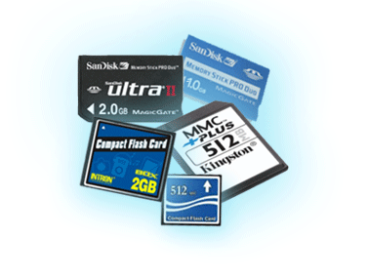
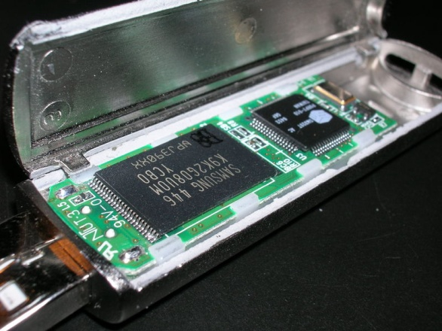
Flash Storage
A type of electrically erasable programmable read-only memory (EEPROM)
Nonvolatile semiconductor storage
100× – 1000× faster than disk
Smaller, lower power, more robust
But more $/GB (between disk and DRAM)

Slide 13
Flash Types
NOR flash: bit cell like a NOR gate
Random read/write access
Used for instruction memory in embedded systems
NAND flash: bit cell like a NAND gate
Denser (bits/area), but block-at-a-time access
Cheaper per GB
Used for USB keys, media storage, …
Flash bits wears out after 1000’s of accesses
Not suitable for direct RAM or disk replacement
Wear leveling: remap data to less used blocks

Slide 14
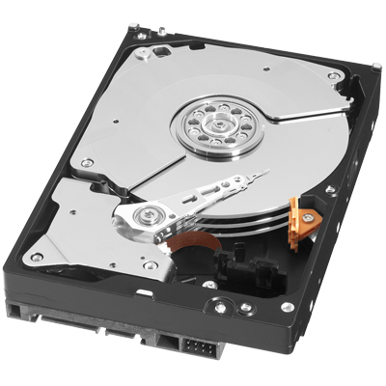
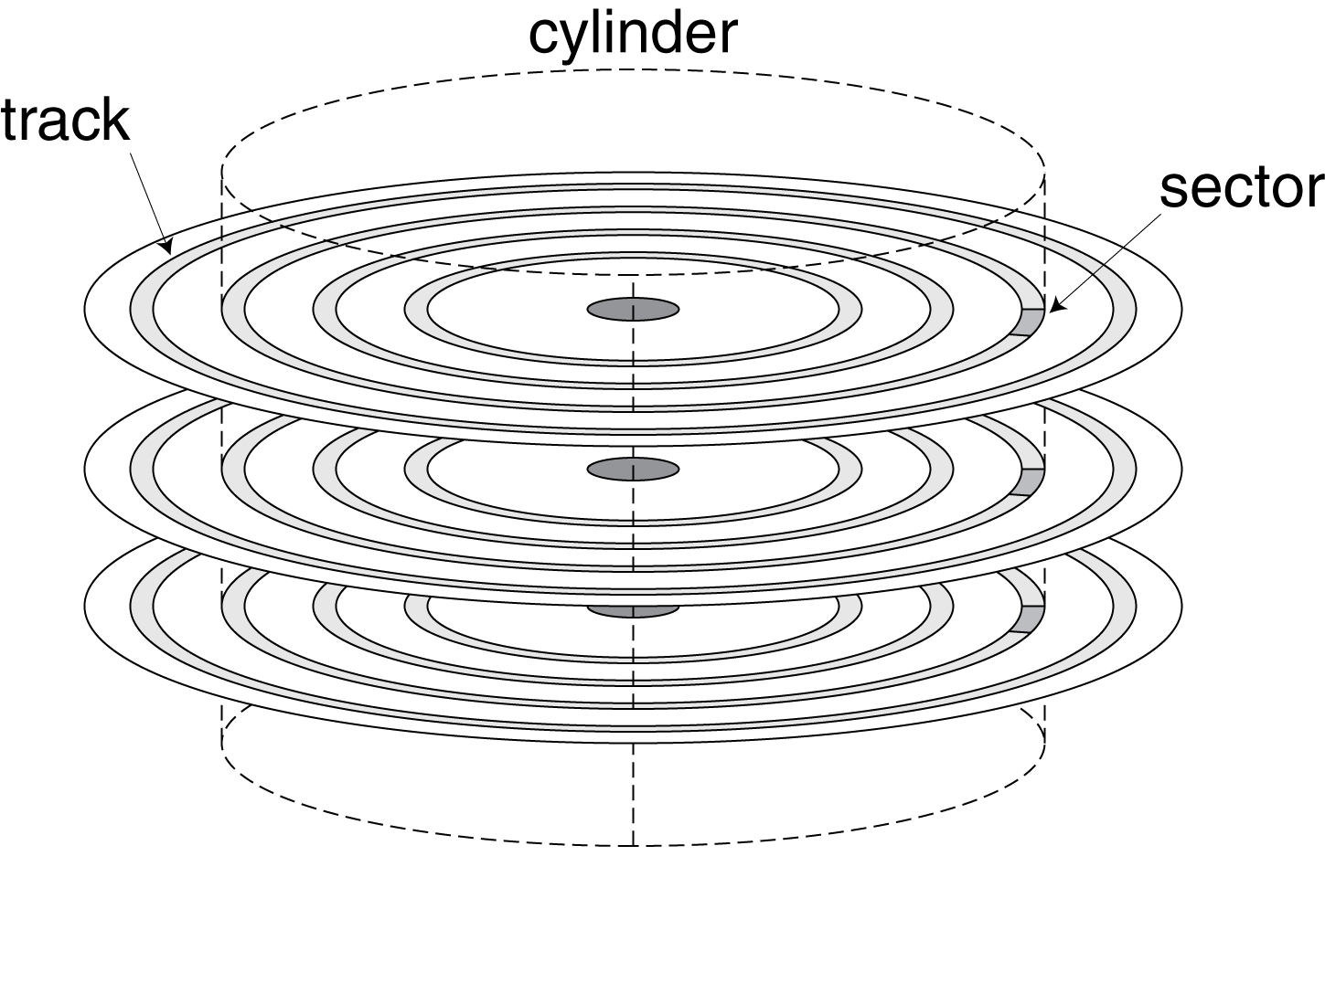
Disk Storage
Nonvolatile, rotating magnetic storage
Disk surface is divided into concentric circles, called tracks
Sector: One of the segments that make up a track on a magnetic disk; a sector is the smallest amount of information that is read or written on a disk (512 to 4096 bytes).
Cylinder: all the tracks under the heads at a given point on all surfaces.

Slide 15
Disk Sectors and Access
Each sector records
Sector ID
Data (512 bytes, 4096 bytes proposed)
Error correcting code (ECC)
Used to hide defects and recording errors
Synchronization fields and gaps
Access to a sector involves
Queuing delay if other accesses are pending
Seek: move the heads over the proper track on a disk (3ms to 13ms).
Rotational latency: the time for the desired sector to rotate under the read/write head (5400 RPM to 15000RPM).
Data transfer: the time to transfer a block of bits.
Controller overhead

Slide 16
Disk Access Example
Given
512B sector, 15,000rpm, 4ms average seek time, 100MB/s transfer rate, 0.2ms controller overhead, idle disk
Average read time
4ms seek time + ½ / (15,000/60) = 2ms rotational latency + 512 / 100MB/s = 0.005ms transfer time + 0.2ms controller delay = 6.2ms
If actual average seek time is 1ms
Average read time = 3.2ms

Slide 17
Disk Performance Issues
Manufacturers quote average seek time
Based on all possible seeks
Locality and OS scheduling lead to smaller actual average seek times
Smart disk controller allocate physical sectors on disk
Present logical sector interface to host
SCSI, ATA, SATA
Disk drives include caches
Prefetch sectors in anticipation of access
Avoid seek and rotational delay

Slide 18
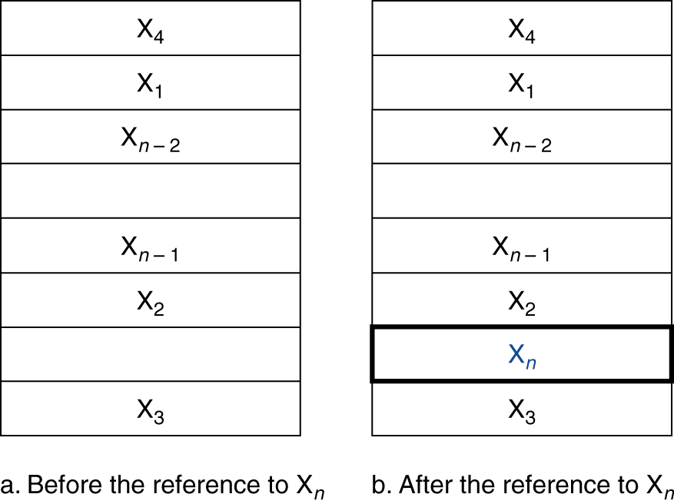
5.3 The Basics of Cache Memory
Cache: used to refer to any storage managed to take advantage of locality of access
Cache memory
The level of the memory hierarchy closest to the CPU
Given accesses X₁, …, X_{n–1}, X_{n}
Initially, the word X_{n} is not-exist (miss)
How do we know if the data is present?
Where do we look?
Location of each word in the memory is determined by its address

Slide 19
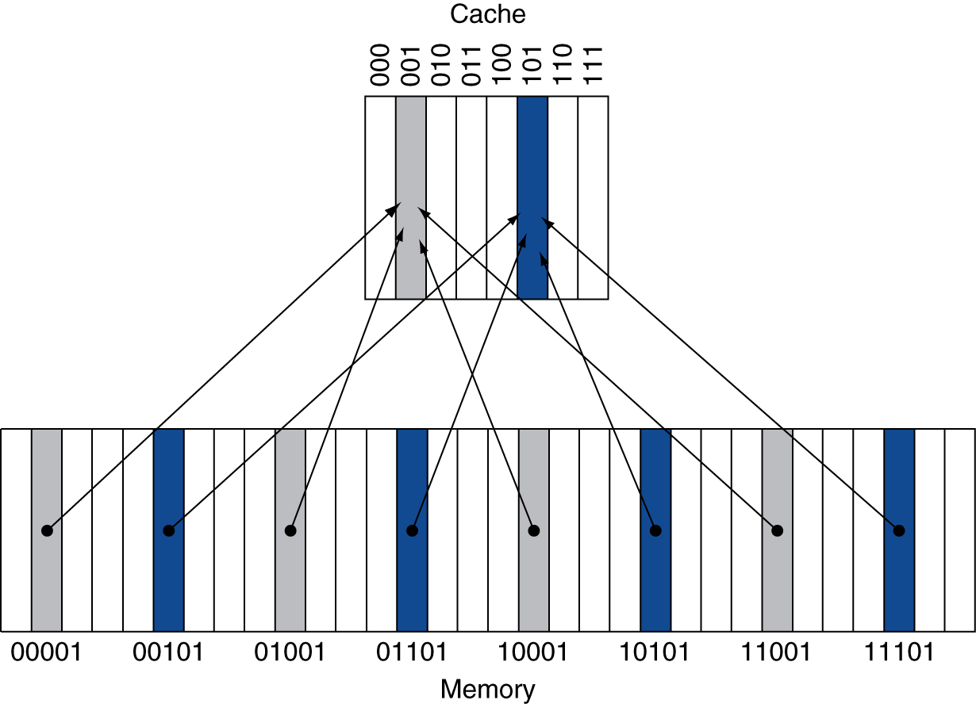
Direct Mapped Cache
Direct mapped: each memory location is mapped directly to exactly one location in the cache:
The block in the cache is determined by:
(Block address) modulo (#Blocks in cache)
#Blocks is a power of 2
Use low-order address bits
8-block $
For the given cache, a given block could be from 4 blocks of the memory
The $ has 8 words

Slide 20
Tags and Valid Bits
How do we know which particular block is stored in a cache location?
Store block address as well as the data
Actually, only need the high-order bits
lower-order bits are used as index into the cache to specify the block address
Called the tag
What if there is no data in a location?
Valid bit: 1 = present, 0 = not present
Initially 0
Handling reads is simpler than handling writes, since reads do not have to change the contents of the cache

Slide 21
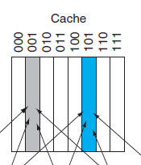
Cache Example

Slide 22
Cache Example
8-blocks, 1 word/block, direct mapped
Initial state
Index | V | Tag | Data
000 | N
001 | N
010 | N
011 | N
100 | N
101 | N
110 | N
111 | N

Slide 23
Cache Example
Word addr | Binary addr | Hit/miss | Cache block
22 | 10 110 | Miss | 110
Index | V | Tag | Data
000 | N
001 | N
010 | N
011 | N
100 | N
101 | N
110 | Y | 10 | Mem[10110]
111 | N

Slide 24
Cache Example
Word addr | Binary addr | Hit/miss | Cache block
26 | 11 010 | Miss | 010
Index | V | Tag | Data
000 | N
001 | N
010 | Y | 11 | Mem[11010]
011 | N
100 | N
101 | N
110 | Y | 10 | Mem[10110]
111 | N

Slide 25
Cache Example
Word addr | Binary addr | Hit/miss | Cache block
22 | 10 110 | Hit | 110
26 | 11 010 | Hit | 010
Index | V | Tag | Data
000 | N
001 | N
010 | Y | 11 | Mem[11010]
011 | N
100 | N
101 | N
110 | Y | 10 | Mem[10110]
111 | N

Slide 26
Cache Example
Word addr | Binary addr | Hit/miss | Cache block
16 | 10 000 | Miss | 000
3 | 00 011 | Miss | 011
16 | 10 000 | Hit | 000
Index | V | Tag | Data
000 | Y | 10 | Mem[10000]
001 | N
010 | Y | 11 | Mem[11010]
011 | Y | 00 | Mem[00011]
100 | N
101 | N
110 | Y | 10 | Mem[10110]
111 | N

Slide 27
Cache Example
Word addr | Binary addr | Hit/miss | Cache block
18 | 10 010 | Miss | 010
Index | V | Tag | Data
000 | Y | 10 | Mem[10000]
001 | N
010 | Y | 10 | Mem[10010]
011 | Y | 00 | Mem[00011]
100 | N
101 | N
110 | Y | 10 | Mem[10110]
111 | N

Slide 28
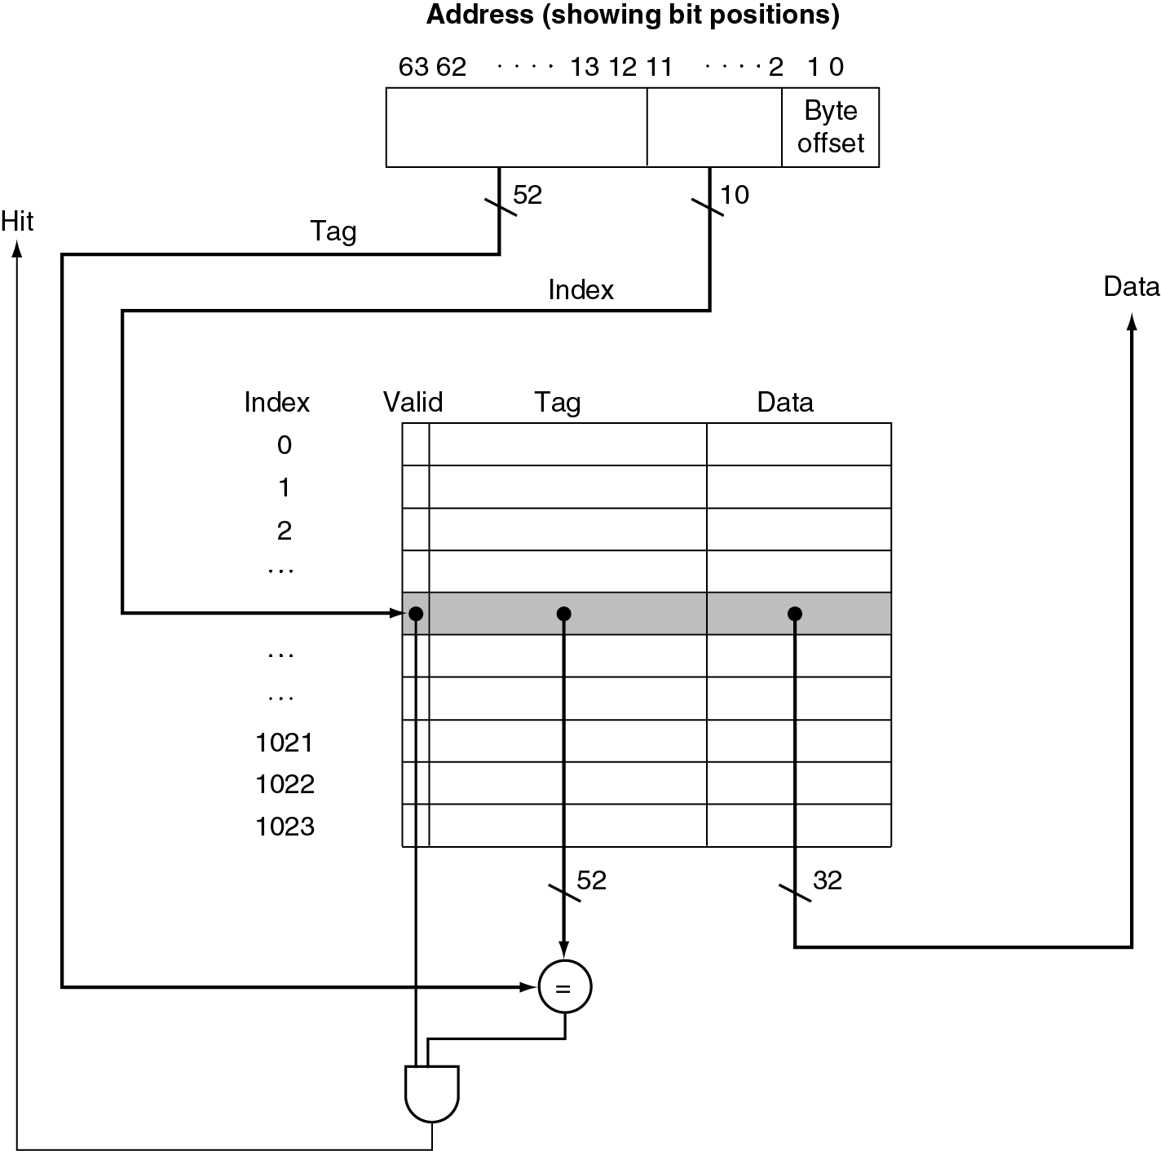
Address Subdivision
The address is divided into
A tag field, which is used to compare with the value of the tag field of the cache
A cache index, which is used to select the block
Words are aligned to multiples of four bytes. Therefore, the least significant two bits of every address specify a byte within a word.
The total number of bits needed for a cache is a function of the cache size and the address size, because the cache includes both the storage for the data and the tags.
The size of the block above was one word (=4 bytes), but normally it is several.
The size of the given cache is 1024 word = 1K word = 4 K Bytes = 4KiB

Slide 29
Address Subdivision Example
Consider the following situation:
64-bit addresses
A direct-mapped cache
The cache size is 2^{n} blocks, so n bits are used for the index
The block size is 2^{m} words (2^{m+2} bytes = 2^{m+5} bits), so m bits are used for the word within the block, and two bits are used for the byte part of the address
The size of the tag field is 64 − (n + m + 2).
The total number of bits in a direct-mapped cache is 2^{n} ×(block size + tag size + valid field size).
Although this is the actual size in bits, the naming convention is to exclude the size of the tag and valid field and to count only the size of the data.
Thus, the cache in previous Figure is called a 4 KiB cache.

Slide 30
Example 1
word=4 bytes
Block= 4 words= 16 byte =16*8= 128 bit

Slide 31
Example 2

Slide 32
Example: Larger Block Size
64 blocks, 16 bytes/block
To what block number does address 1200 map?
Block address = ⎣1200/16⎦ = 75
Block number = 75 modulo 64 = 11
63
10
9
4
3
0
Tag
Index
Offset
22 bits
6 bits
4 bits

Slide 33
Block Size Considerations
Larger blocks should reduce miss rate
Due to spatial locality
But in a fixed-sized cache
Larger blocks ⇒ fewer of them
More competition ⇒ increased miss rate
Larger blocks ⇒ pollution ( Loading a large cache block which contain unnecessary information will cause other useful data to be evicted from the cache into lower levels of the memory hierarchy, degrading performance).
Miss penalty: the time required to fetch the block from the next lower level of the hierarchy and load it into the cache.
The time to fetch the block has two parts:
The latency to the first word
The transfer time for the rest of the block.
Larger miss penalty
Can override benefit of reduced miss rate
Early restart and critical-word-first can help

Slide 34
Cache Misses
On cache hit, CPU proceeds normally
On cache miss
Stall the CPU pipeline
Fetch block from next level of hierarchy
Instruction cache miss
Restart instruction fetch
Data cache miss
Complete data access

Slide 35
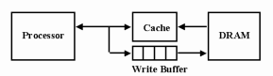
Write-Through
On data-write hit, could just update the block in cache
But then cache and memory would be inconsistent
Write-through: also update memory
But makes writes take longer
e.g., if base CPI = 1, 10% of instructions are stores, write to memory takes 100 cycles
Effective CPI = 1 + 0.1×100 = 11
Solution: write buffer
Holds data waiting to be written to memory
CPU continues immediately
Only stalls on write if write buffer is already full

Slide 36
Write-Back
Alternative: On data-write hit, just update the block in cache
Keep track of whether each block is dirty
When a dirty block is replaced
Write it back to memory
Can use a write buffer to allow replacing block to be read first
Write-back schemes can improve performance, especially when processors can generate writes as fast or faster than the writes can be handled by main memory.
Write-back scheme is more complex to implement than write-through.

Slide 37
Write Allocation
What should happen on a write miss?
Alternatives for write-through
Write Allocate on miss: fetch the block (The block is fetched from memory and then the appropriate portion of the block is overwritten).
No Write Allocate on miss/ Write around: don’t fetch the block (update the portion of the block in memory but not put it in the cache)
For write-back
Usually fetch the block

Slide 38
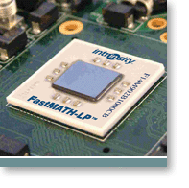
Example: Intrinsity FastMATH
Embedded MIPS processor
12-stage pipeline
Instruction and data access on each cycle
Split cache: separate I-cache and D-cache
Each 16KB: 256 blocks × 16 words/block
(256 block x 16 words/block x 4 bytes/word = 16K bytes)
D-cache: write-through or write-back
SPEC2000 miss rates
I-cache: 0.4%
D-cache: 11.4%
Weighted average: 3.2%
Miss rate is an important characteristic of cache designs.
The ultimate measure is the effect of the memory system on program execution time.

Slide 39
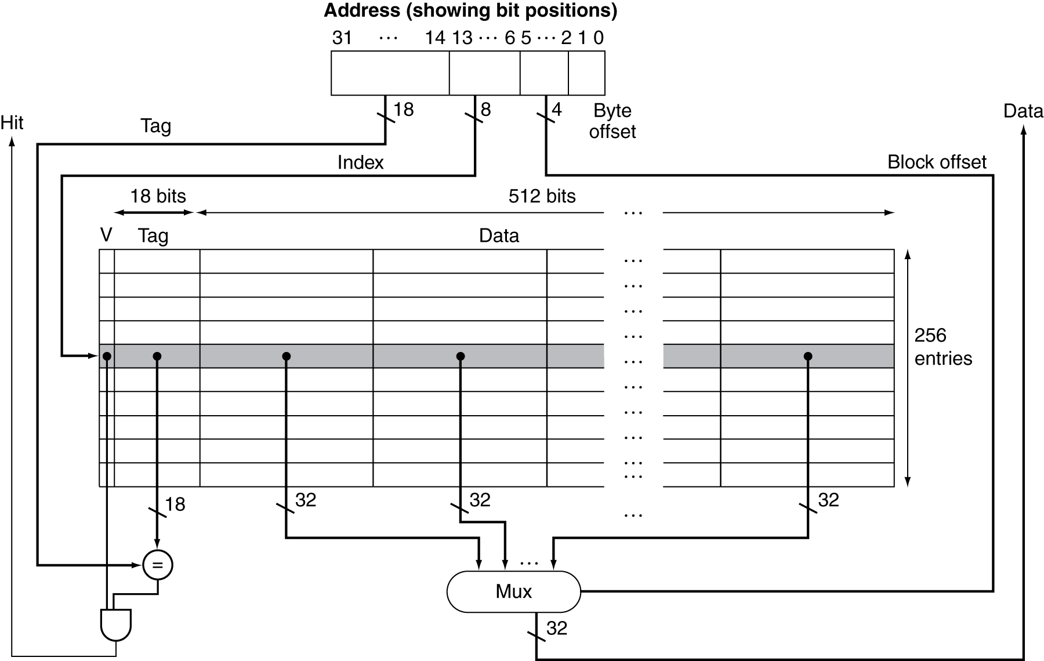
Example: Intrinsity FastMATH
word=4 bytes
Block= 4 words= 16 byte =16*8= 128 bit
16 x 4 x 8 = 512

Slide 40
Split / combined cache
Split cache: A scheme in which a level of the memory hierarchy is composed of two independent caches that operate in parallel with each other, with one handling instructions and one handling data.
A combined cache with a total size equal to the sum of the two split caches will usually have a better hit rate.
The miss rate of the split cache is only slightly worse.
Supporting both an instruction and data access simultaneously
Doubling the cache bandwidth ☺
Slightly increased miss rate ☹
This observation cautions us that we cannot use miss rate as the sole measure of cache performance

Slide 41
Main Memory Supporting Caches
Use DRAMs for main memory
Fixed width (e.g., 1 word)
Connected by fixed-width clocked bus
Bus clock is typically slower than CPU clock
Example cache block read
1 bus cycle for address transfer
15 bus cycles per DRAM access
1 bus cycle per data transfer
For 4-word block, 1-word-wide DRAM
Miss penalty = 1 + 4×15 + 4×1 = 65 bus cycles
Bandwidth = 16 bytes / 65 cycles = 0.25 B/cycle

Slide 42
5.4 Measuring Cache Performance
Components of CPU time
Program execution cycles
Includes cache hit time
Memory stall cycles
Mainly from cache misses
With simplifying assumptions:

Slide 43
5.4 Measuring Cache Performance

Slide 44
Cache Performance Example
Given
I-cache miss rate = 2%
D-cache miss rate = 4%
Miss penalty = 100 cycles
Base CPI (ideal cache) = 2
Load & stores are 36% of instructions
Determine: how much faster a processor would run with a perfect cache that never missed
Miss cycles per instruction
I-cache: 0.02 × 100 = 2 (Instruction miss cycles = I×2%×100 = 2.00×I)
D-cache: 0.36 × 0.04 × 100 = 1.44 (Data miss cycles = I×36%×4%×100 = 1.44×I)
Actual CPI = 2 + 2 + 1.44 = 5.44
Ideal CPU is 5.44/2 =2.72 times faster

Slide 45
Cache Performance Example
What happens if the processor is made faster, but the memory system is not?
Suppose we speed-up the computer in the previous example by reducing its CPI from 2 to 1 without changing the clock rate, which might be done with an improved pipeline.
The system with cache misses would then have a CPI of 1 + 3.44 = 4.44
The system with the perfect cache would be 4.44/1 = 4.44 times as fast.
The amount of execution time spent on memory stalls was 3.44/ 5.44 = 63%
Now, the amount of execution time spent on memory stalls is 3.44/ 4.44 = 77%

Slide 46
Average Access Time
Hit time is also important for performance
Average memory access time (AMAT)
AMAT = Hit time + Miss rate × Miss penalty
Example
CPU with 1ns clock,
Hit time = 1 cycle,
Miss penalty = 20 cycles,
I-cache miss rate = 5%
AMAT = 1 + 0.05 × 20 = 2ns
2 cycles per instruction

Slide 47
Performance Summary
When CPU performance increased
Miss penalty becomes more significant
Decreasing base CPI
Greater proportion of time spent on memory stalls
Increasing clock rate
Memory stalls account for more CPU cycles
Can’t neglect cache behavior when evaluating system performance

Slide 48
Associative Caches
Direct mapping: A block can go in exactly one place in the cache
Fully associative
Allow a given block to go in any cache entry
Requires all entries to be searched at once to find the required block
Parallel search by having comparator per entry (expensive)
The middle range of designs between direct mapped and fully associative is called set associative.

Slide 49
Associative Caches
Set-associative cache: A cache that has a fixed number of locations (at least two) where each block can be placed.
n-way set associative
Each set contains n entries → there is n locations for a block
Block number determines which set
(Block number) modulo (#Sets in cache)
Search all entries in a given set at once
n comparators (less expensive)
compare with all the tags of all the elements of the set

Slide 50
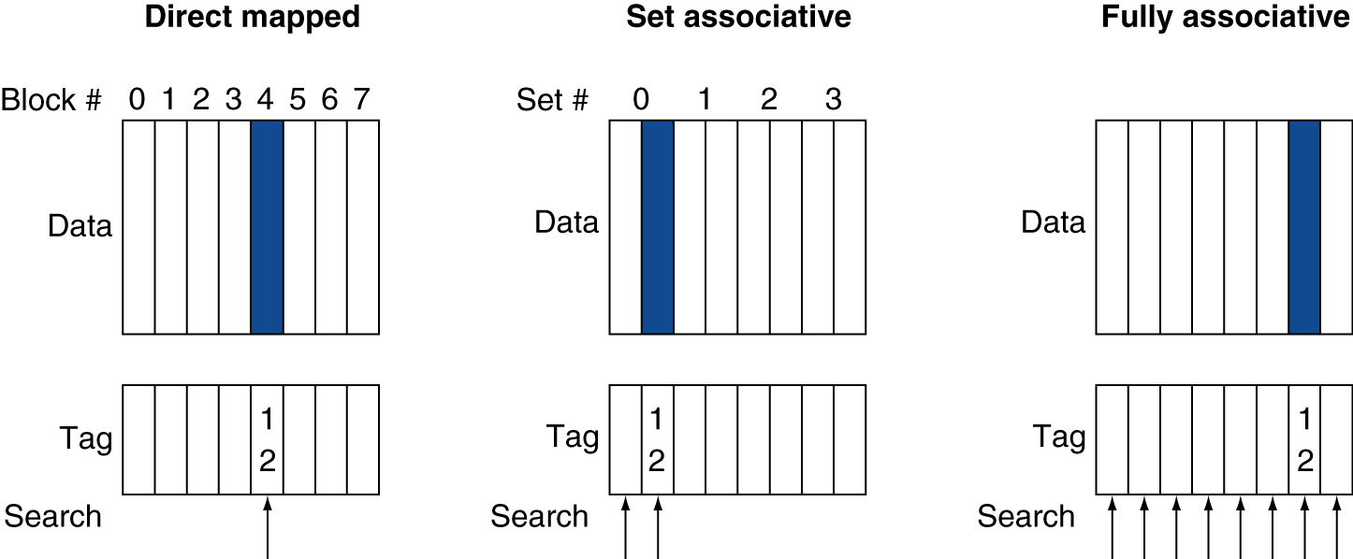
Associative Cache Example

Slide 51
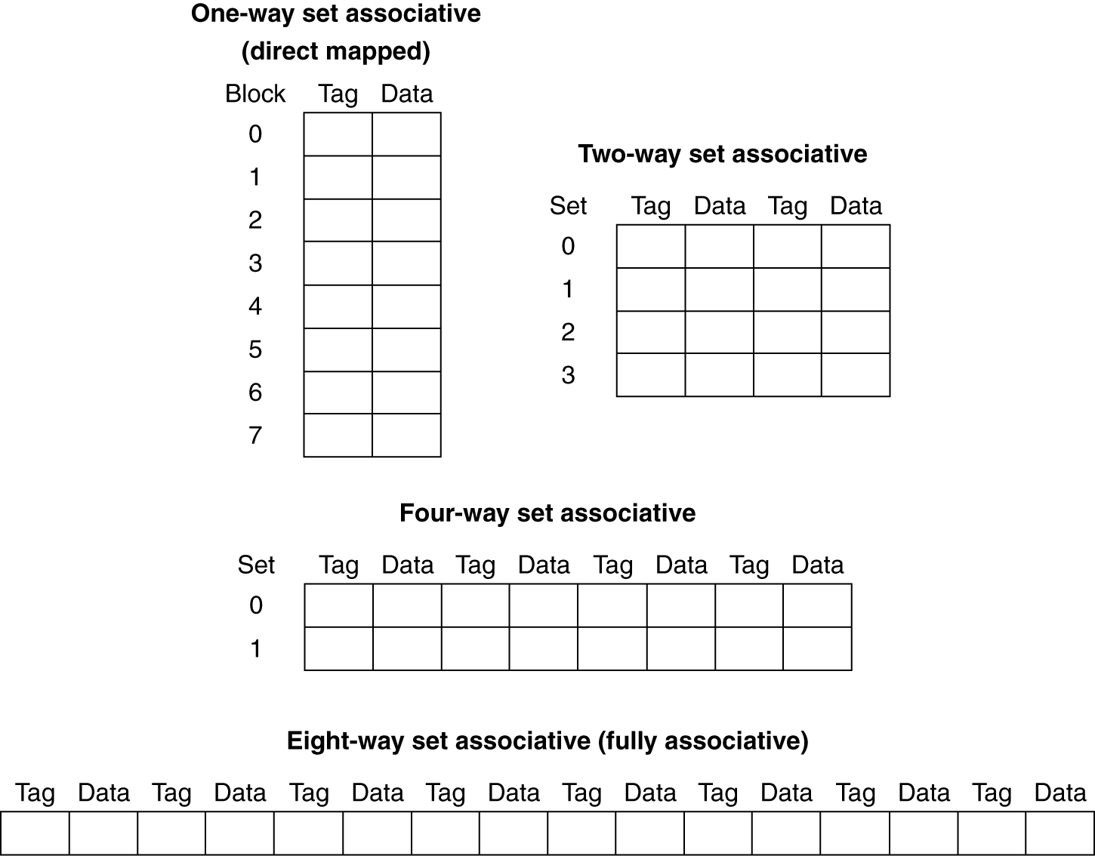
Spectrum of Associativity
For a cache with 8 entries/blocks
Increasing the degree of associativity will decrease the miss rate ☺
Increasing the degree of associativity will increase the hit time ☹

Slide 52
Associativity Example
Compare 4-block caches
Direct mapped, 2-way set associative, fully associative
Block access sequence: 0, 8, 0, 6, 8
Direct mapped
For each block address, determine the cache block
The direct-mapped cache generates five misses for the five accesses
Block address | Cache index | Hit/miss | Cache content after access
 |  |  | 0 | 1 | 2 | 3
0 | 0 | miss | Mem[0]
8 | 0 | miss | Mem[8]
0 | 0 | miss | Mem[0]
6 | 2 | miss | Mem[0] |  | Mem[6]
8 | 0 | miss | Mem[8] |  | Mem[6]

Slide 53
Associativity Example
2-way set associative
First, determine to which set each block address maps
Set-associative caches usually replace the least recently used block within a set; that is, the block that was used furthest in the past is replaced.
The two-way set-associative cache has four misses, one less than the direct-mapped cache
Block address | Cache index | Hit/miss | Cache content after access
 |  |  | Set 0 |  | Set 1
0 | 0 | miss | Mem[0]
8 | 0 | miss | Mem[0] | Mem[8]
0 | 0 | hit | Mem[0] | Mem[8]
6 | 0 | miss | Mem[0] | Mem[6]
8 | 0 | miss | Mem[8] | Mem[6]

Slide 54
Associativity Example
Fully associative
has four cache blocks (in a single set);
Any memory block can be stored in any cache block.
Has the best performance, with only three misses:
Block address |  | Hit/miss | Cache content after access
0 |  | miss | Mem[0]
8 |  | miss | Mem[0] | Mem[8]
0 |  | hit | Mem[0] | Mem[8]
6 |  | miss | Mem[0] | Mem[8] | Mem[6]
8 |  | hit | Mem[0] | Mem[8] | Mem[6]

Slide 55
How Much Associativity
Increased associativity decreases miss rate
But with diminishing returns
Simulation of a system with 64KB D-cache, 16-word blocks, SPEC2000
1-way: 10.3%
2-way: 8.6%
4-way: 8.3%
8-way: 8.1%

Slide 56
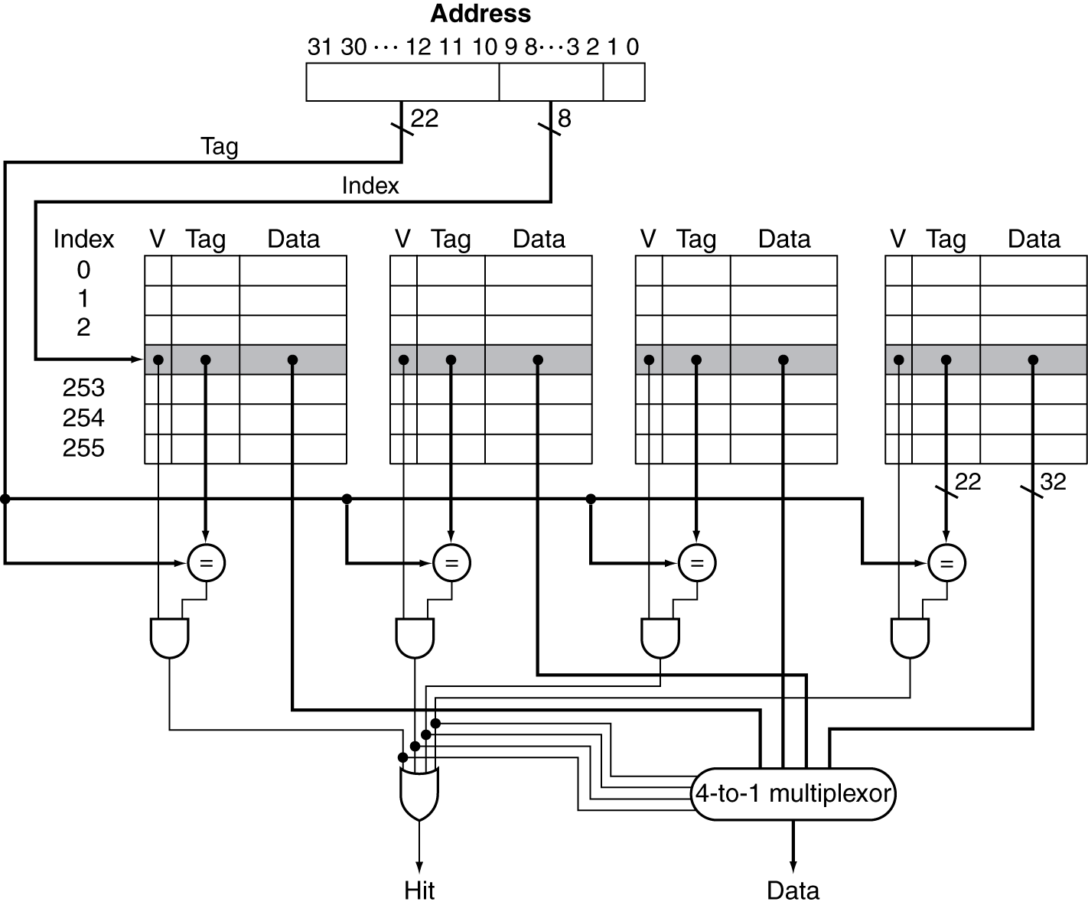
Set Associative Cache Organization
The index value is used to select the set containing the address of interest.
The tags of all the blocks in the set must be searched.

Slide 57
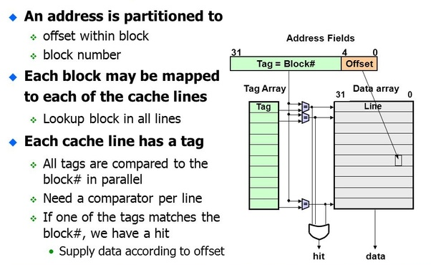
Fully-Associative Cache Organization
In a fully associative cache, there is effectively only one set, and all the blocks must be checked in parallel.
Thus, there is no index, and the entire address, excluding the block offset, is compared against the tag of every block
In a direct-mapped cache, only a single comparator is needed, because the entry can be in only one block, and we access the cache simply by indexing.

Slide 58
Replacement Policy
Direct mapped: no choice
Set associative
Prefer non-valid entry, if there is one
Otherwise, choose among entries in the set
Least-recently used (LRU)
Choose the one unused for the longest time
Simple for 2-way, manageable for 4-way, too hard beyond that
Random
Gives approximately the same performance as LRU for high associativity
Fully Associative: all blocks are candidates for replacement

Slide 59
Size of Tags versus Set Associativity
Cache size = 4K block
Block size= 4 Word=16Bytes
Direct Mapping:
#Sets = # Blocks
#Sets = 4K
2-Way Set Associative
#Sets = 2K
4-Way Set Associative
#Sets = 1K
Fully Associative
#Sets = 1

Slide 60
Multilevel Caches
Used to reduce miss penalty
Primary cache attached to CPU
Small, but fast
Level-2 cache services misses from primary cache
Larger, slower, but still faster than main memory
If the second-level cache contains the desired data, the miss penalty for the first-level cache will be essentially the access time of the second-level cache
Main memory services L-2 cache misses
Some high-end systems include L-3 cache

Slide 61
Performance of Multilevel Caches
Given
CPU base CPI = 1, clock rate = 4GHz → clock period=0.25ns
Miss rate/instruction = 2%
Main memory access time = 100ns
With just primary cache
Miss penalty = 100ns/0.25ns = 400 cycles
Effective CPI = 1 + 0.02 × 400 = 9

Slide 62
Example (cont.)
Now add L-2 cache
Access time = 5ns
Global miss rate to main memory = 0.5%
Primary miss with L-2 hit
Penalty = 5ns/0.25ns = 20 cycles
Primary miss with L-2 miss
Extra penalty = 500 cycles
CPI = 1 + 0.02 × 20 + 0.005 × 400 = 3.4
Performance ratio = 9/3.4 = 2.6

Slide 63
Multilevel Cache Considerations
Primary cache
Focus on minimal hit time → shorter clock cycle
L-2 cache
Focus on low miss rate to avoid main memory access
Hit time has less overall impact
Results
L-1 cache usually smaller than a single cache
L-1 block size smaller than L-2 block size

Slide 64
Interactions with Advanced CPUs
Out-of-order CPUs can execute instructions during cache miss
Pending store stays in load/store unit
Dependent instructions wait in reservation stations
Independent instructions continue
Effect of miss depends on program data flow
Much harder to analyse
Use system simulation

Slide 65
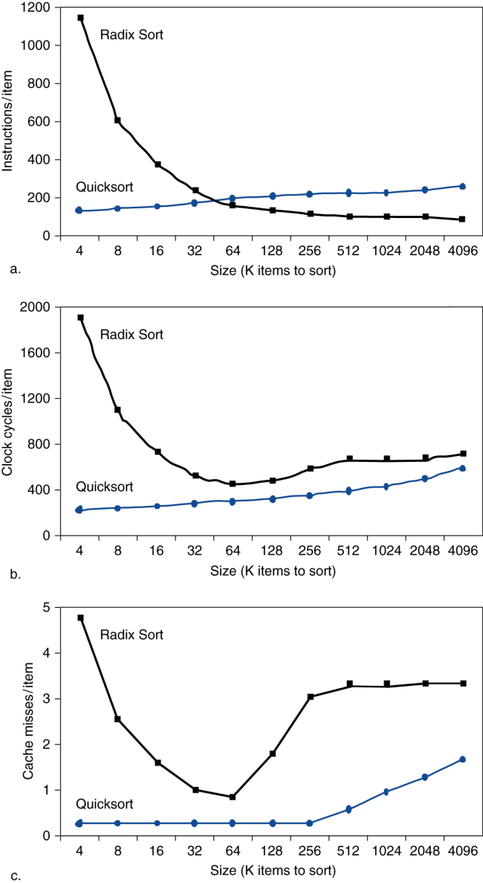
Interactions with Software
Misses depend on memory access patterns
Algorithm behavior
Compiler optimization for memory access

Slide 66
5.5 Dependable Memory Hierarchy
Service accomplishment
Service delivered as specified
Fault: failure of a component
May or may not lead to system failure
Failures can be permanent or intermittent
This leads to two related terms:
reliability and availability.
Restoration
Failure
Service interruption
Deviation from specified service
Notes:
https://www.eventhelix.com/fault-handling/reliability-availability-basics/

Slide 67
Dependability Measures
Reliability: mean time to failure (MTTF)
Service interruption: mean time to repair (MTTR)
A related term is annual failure rate (AFR), which is just the percentage of devices that would be expected to fail in a year for a given MTTF
Mean time between failures
MTBF = MTTF + MTTR
Availability = MTTF / (MTTF + MTTR)
Improving Availability
Increase MTTF: fault avoidance, fault tolerance using redundancy, fault forecasting
Reduce MTTR: improved tools and processes for diagnosis and repair
Notes:
https://www.eventhelix.com/fault-handling/reliability-availability-basics/

Slide 68
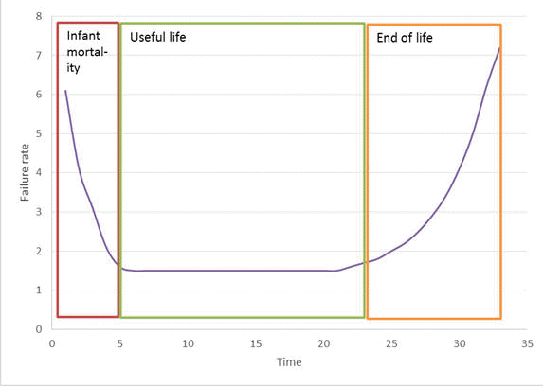
Hardware failures
Hardware failures are typically characterized by a bath tub curve.
The chance of a hardware failure is high during the initial life of the module.
The failure rate during the rated
useful life of the product is fairly low.
Once the end of the life is reached,
failure rate of modules increases again.
Notes:
https://www.eventhelix.com/fault-handling/reliability-availability-basics/

Slide 69
Causes of Hardware failures
Design failures: Take place due to inherent design flaws in the system. In a well-designed system this class of failures should make a very small contribution to the total number of failures.
Infant Mortality: This class of failures cause newly manufactured hardware to fail. Can be attributed to manufacturing problems like poor soldering, leaking capacitor etc. These failures should not be present in systems leaving the factory as these faults will show up in factory system burn in tests.
Random Failures: Can occur during the entire life of a hardware module. Can lead to system failures. Redundancy is provided to recover from this class of failures.
Wear Out: Once a hardware module has reached the end of its useful life, degradation of component characteristics will cause hardware modules to fail. This type of faults can be weeded out by preventive maintenance and routing of hardware.
Notes:
https://www.eventhelix.com/fault-handling/reliability-availability-basics/

Slide 70
System Availability
System Availability is calculated by modeling the system as an interconnection of parts in series and parallel.
The following rules are used to decide if components should be placed in series or parallel:
If failure of a part leads to the combination becoming inoperable, the two parts are considered to be operating in series
If failure of a part leads to the other part taking over the operations of the failed part, the two parts are considered to be operating in parallel.
Notes:
https://www.eventhelix.com/fault-handling/reliability-availability-basics/

Slide 71
Availability in Series
Two parts X and Y are considered to be operating in series if failure of either of the parts results in failure of the combination.
The combined system is operational only if both Part X and Part Y are available.
From this it follows that the combined availability is a product of the availability of the two parts.
The combined availability is shown by A = A_{x} A_{y}
Thus,the combined availability of two components in series is always lower than the availability of its individual components.
Notes:
https://www.eventhelix.com/fault-handling/reliability-availability-basics/

Slide 72

Availability in Parallel
Two parts are considered to be operating in parallel if the combination is considered failed when both parts fail.
The combined availability is 1 - (both parts are unavailable).
The combined availability is shown by A = 1 - (1-A_{x} )²
Thus, the combined availability of two components in parallel is always much higher than the availability of its individual components.
Notes:
https://www.eventhelix.com/fault-handling/reliability-availability-basics/

Slide 73
MTTF vs. AFR of Disks

Slide 74
5.7 Virtual Memory
Virtual memory A technique that uses main memory as a “cache” for secondary storage (disk) .
Managed jointly by CPU hardware and the operating system (OS)
Programs share main memory
Each gets a private virtual address space holding its frequently used code and data
Protected from other programs
CPU and OS translate virtual addresses to physical addresses
VM “block” is called a page
VM translation “miss” is called a page fault
Physical address An address in main memory.
Virtual address An address that corresponds to a location in virtual space and is translated by address mapping to a physical address when memory is accessed.

Slide 75
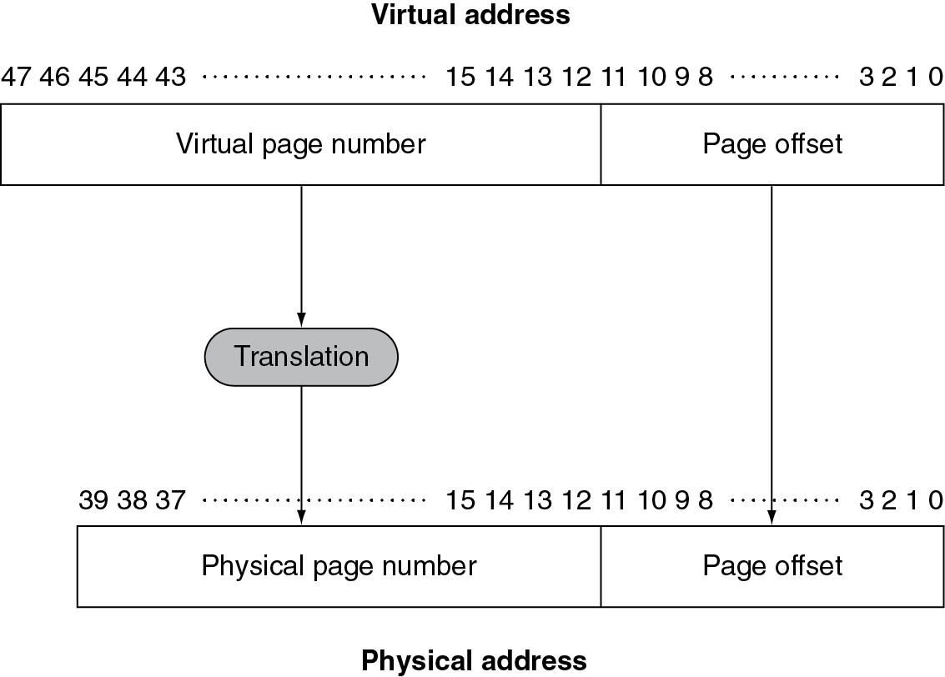
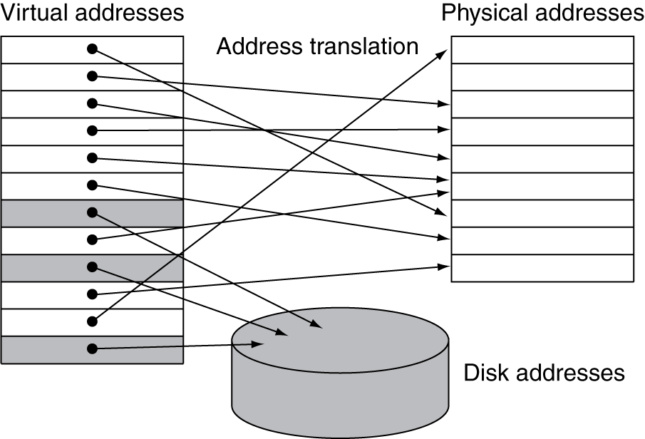
Address Translation
Fixed-size pages (e.g., 4K)
Flash
Magnetic Disk
The physical memory is 1 TiB, or 2⁴⁰ bytes, which needs a 40-bit address
DRAM
It is possible for a virtual page to be absent from main memory and not be mapped to a physical address; in that case, the page resides on disk.
Physical pages can be shared by having two virtual addresses point to the same physical address.

Slide 76
Address Translation
Virtual memory provides relocation.
Relocation maps the virtual addresses used by a program to different physical addresses before the addresses are used to access memory.
This relocation allows us to load the program anywhere in main memory.
Virtual memory systems eliminating the need to find a contiguous block of memory to allocate to a program; instead, the operating system needs only to find enough pages in main memory.

Slide 77
Page Fault Penalty
On page fault, the page must be fetched from disk
Takes millions of clock cycles
Handled by OS code
Try to minimize page fault rate
Pages should be large enough to try to amortize the high access time
Fully associative placement
Smart replacement algorithms
Write-through will not work for virtual memory, since writes take too long.
Instead, virtual memory systems use write-back.

Slide 78
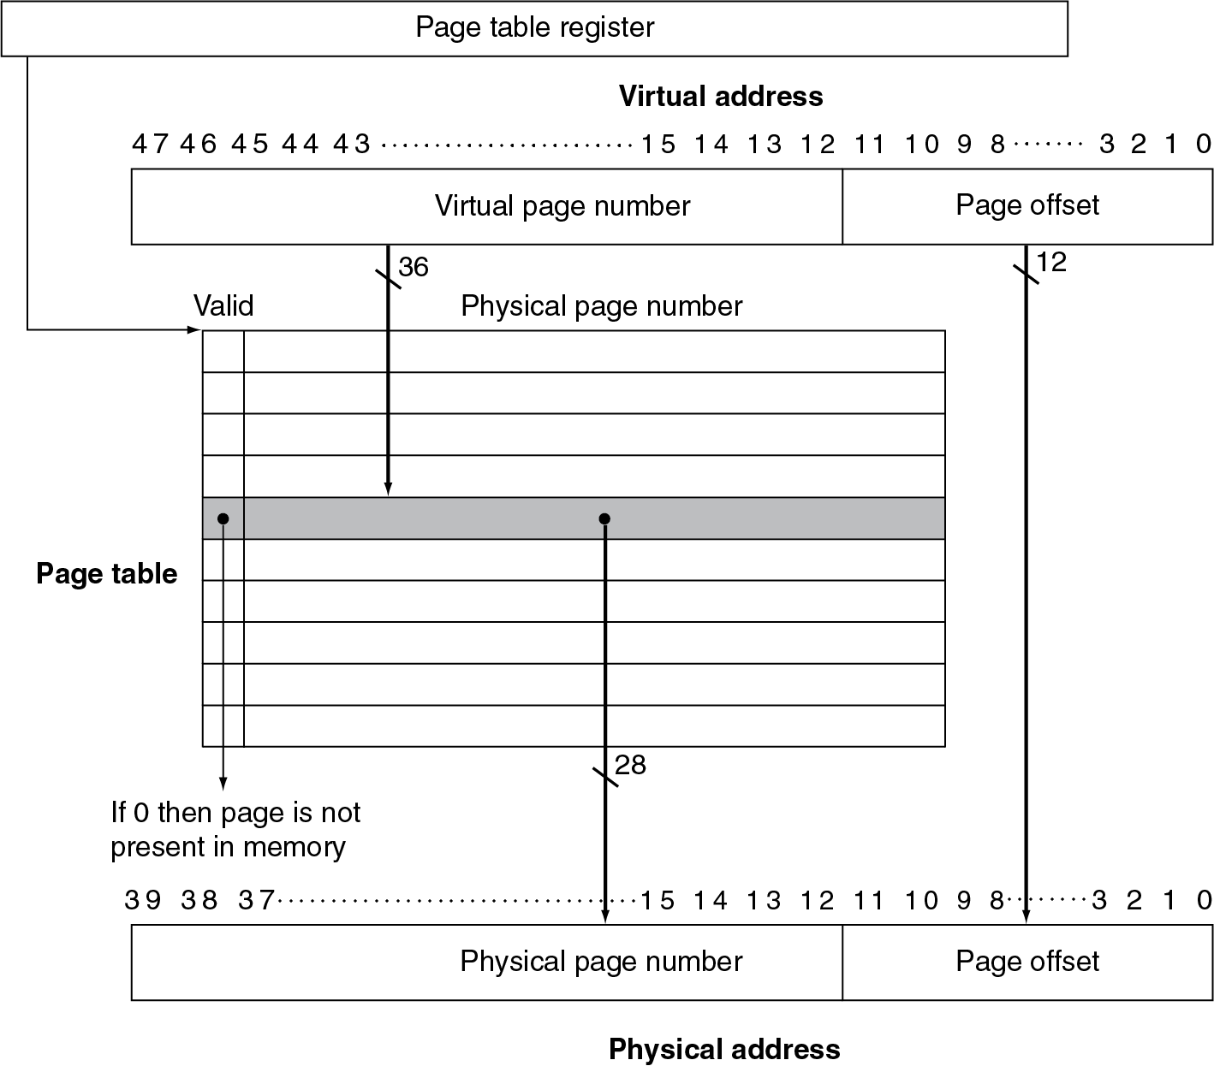
Page Tables
Store placement information
Array of page table entries, indexed by virtual page number
Page table register in CPU points to page table in physical memory
If page is present in memory
PTE stores the physical page number
Plus other status bits (referenced, dirty, …)
If page is not present
PTE can refer to location in swap space on disk

Slide 79
Translation Using a Page Table
The hardware can form a physical address using
The page table register,
The virtual address,
The indicated page table
The virtual address space is 2⁴⁸ bytes, or 256 TiB.
The physical address space is 2⁴⁰ bytes, which allows main memory of up to 1 TiB.
If RISC-V used a single page table as shown in this figure, the number of entries in the page table would be 2³⁶, or about 64 billion entries.
Page size = 4KBit
We’ll see what RISC-V does to reduce the number of entries shortly.

Slide 80
Page Fault
If the valid bit for a virtual page is off, a page fault occurs.
The operating system must be given control.
This transfer is done with the exception mechanism, which we saw in Chapter 4.
Swap space: The space on the disk reserved for the full virtual memory space of a process.

Slide 81
Page Table
With hundreds of processes running, each with its own page table, a large space is required for address translation
Therefore, various techniques can reduce the size of address table, including:
Keep a limit register that restricts the size of the page table for a given process.
The use of two separate page tables and two separate limits, which breaks the address space into two segments.
Applying a hashing function to the virtual address so that the size of the page table equals the size of the number of physical pages in main memory.
Allow the page tables to be paged
Using multiple levels of page tables (this is the solution that RISC-V uses to reduce the memory footprint of address translation)

Slide 82
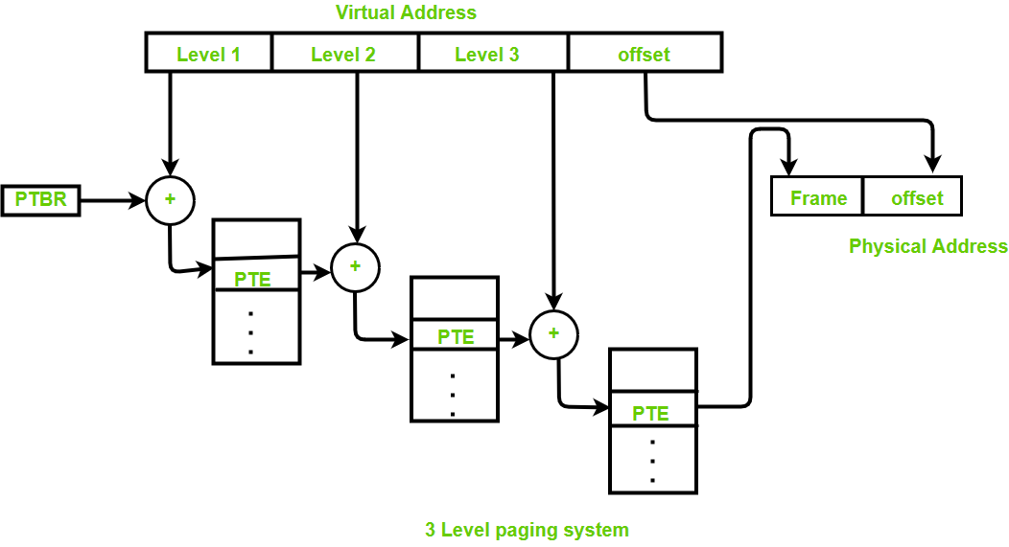
Page Table
RISC-V uses four levels of tables to translate a 48-bit virtual address into a 40-bit physical address
RISC-V uses four levels of tables to translate a 48-bit virtual address into a 40-bit physical address
Notes:
https://www.youtube.com/watch?v=Z4kSOv49GNc
https://www.youtube.com/watch?v=qcBIvnQt0Bw&list=PLiwt1iVUib9s2Uo5BeYmwkDFUh70fJPxX

Slide 83
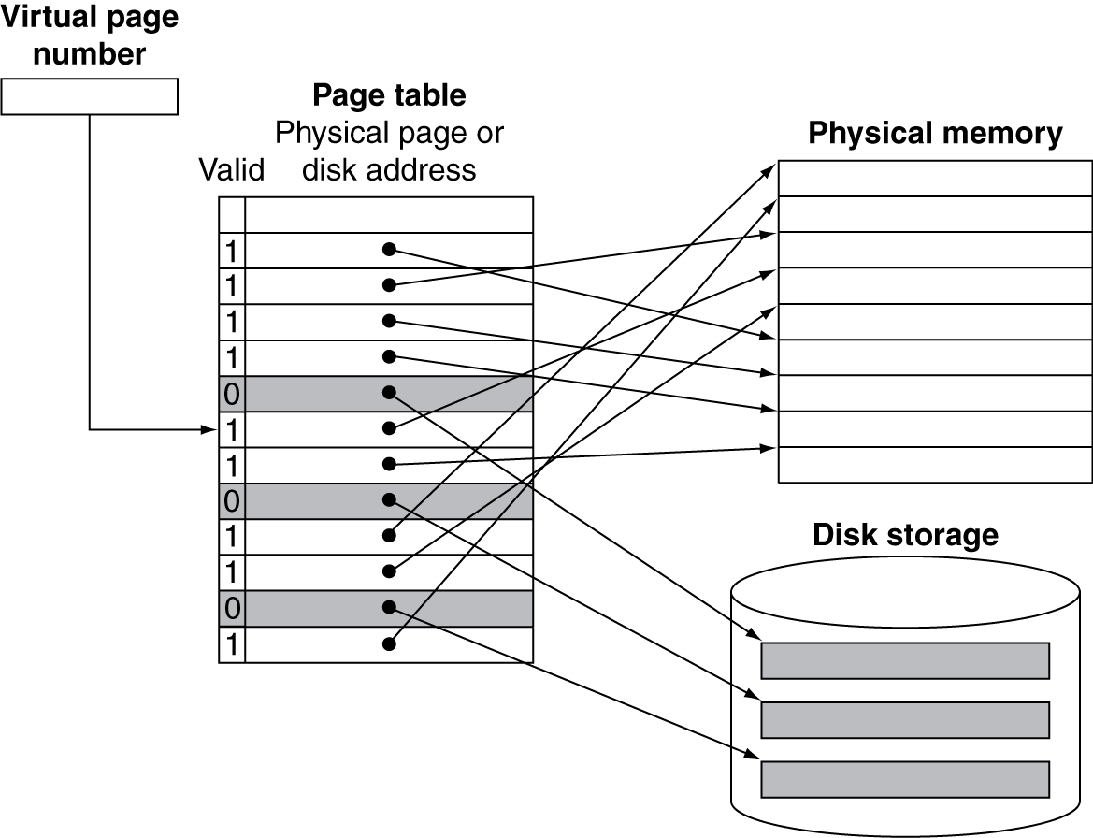
Mapping Pages to Storage

Slide 84
Replacement and Writes
To reduce page fault rate, prefer least-recently used (LRU) replacement
Reference bit (aka use bit) in PTE set to 1 on access to page
Periodically cleared to 0 by OS
A page with reference bit = 0 has not been used recently
Disk writes take millions of cycles
Block at once, not individual locations
Write through is impractical
Use write-back
Dirty bit in PTE set when page is written

Slide 85
Fast Translation Using a TLB
Address translation would appear to require extra memory references
One to access the PTE
Then the actual memory access (get the data)
But access to page tables has good locality
So use a fast cache of PTEs within the CPU
Called a Translation Look-aside Buffer (TLB)
Typical: 16–512 PTEs, 0.5–1 cycle for hit, 10–100 cycles for miss, 0.01%–1% miss rate
Misses could be handled by hardware or software

Slide 86
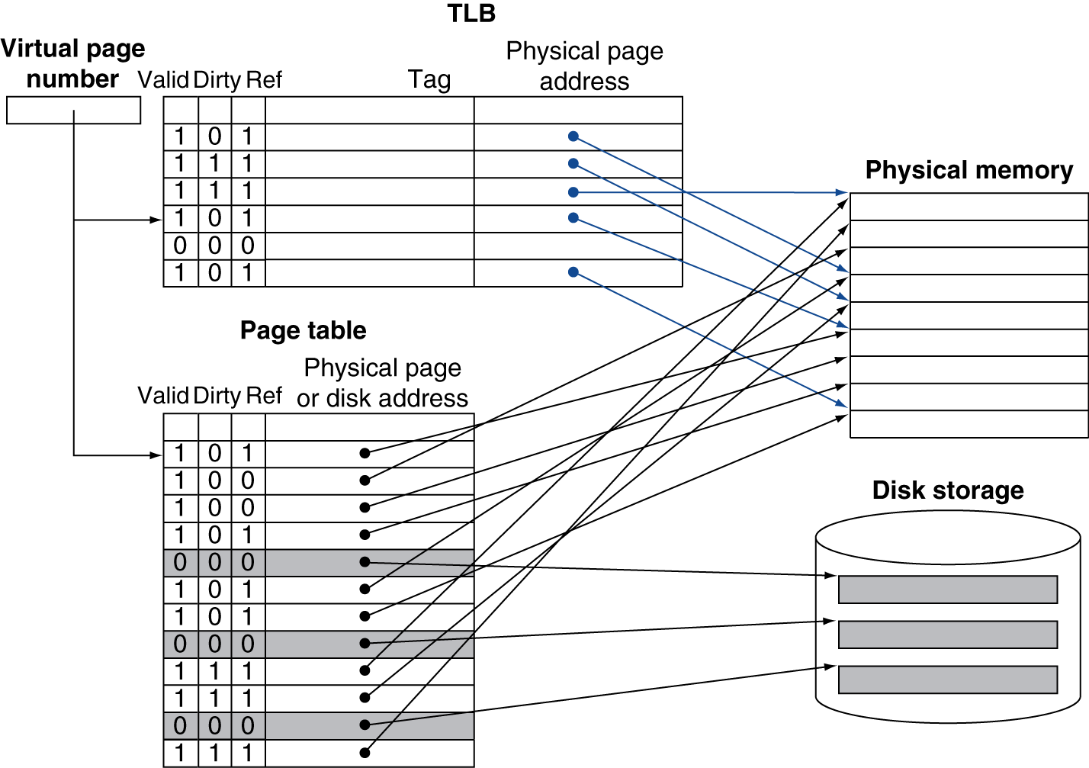
Fast Translation Using a TLB

Slide 87
TLB Misses
If page is in memory
Load the PTE from memory and retry
Could be handled in hardware
Can get complex for more complicated page table structures
Or in software
Raise a special exception, with optimized handler
If page is not in memory (page fault)
OS handles fetching the page and updating the page table
Then restart the faulting instruction

Slide 88
TLB Miss Handler
TLB miss indicates
Page present, but PTE not in TLB
Page not present
Must recognize TLB miss before destination register overwritten
Raise exception
Handler copies PTE from memory to TLB
Then restarts instruction
If page not present, page fault will occur

Slide 89
Page Fault Handler
Use faulting virtual address to find PTE
Locate page on disk
Choose page to replace
If dirty, write to disk first
Read page into memory and update page table
Make process runnable again
Restart from faulting instruction

Slide 90
The Intrinsity FastMATH TLB
The memory system uses 4 KiB pages and a 32-bit address space
The virtual page number is 20 bits long.
The physical address is the same size as the virtual address.
The TLB contains 16 entries, it is fully associative, and it is shared between the instruction and data references.
Each entry is 64 bits wide and contains a 20-bit tag (which is the virtual page number for that TLB entry), the corresponding physical page number (also 20 bits), a valid bit, a dirty bit, and other bookkeeping bits.

Slide 91
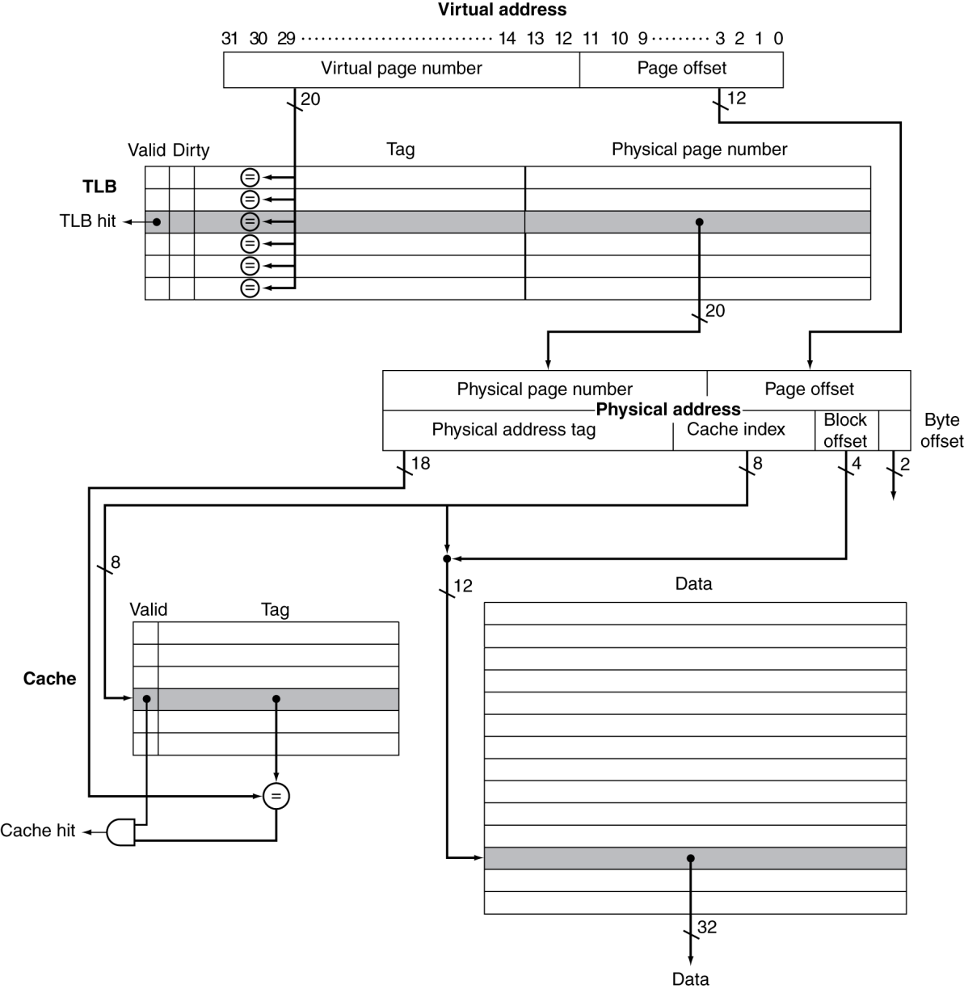
TLB and Cache Interaction
If cache tag uses physical address
Need to translate before cache lookup
Alternative: use virtual address tag
Complications due to aliasing
Different virtual addresses for shared physical address

